Slide 1
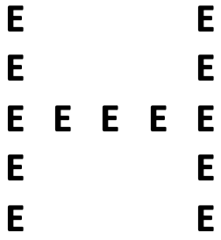

+
1000 ms
+
100 ms
+
150 ms
Answer
1500 ms
Response time =
1500 ms
Time

Slide 2
+
1000 ms
700 ms
<
200 ms
+
200 ms
Answer
1500 ms
Response time =
1500 ms
Time

Slide 3
+
1000 ms
<
180 ms
+
1000 ms
Answer
2000 ms
Response time =
2000 ms
Time

Slide 4
